Slide 1



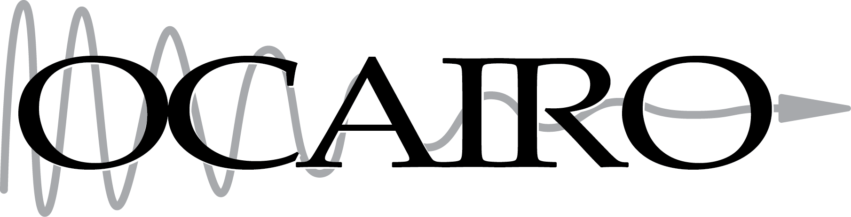

Tutorial: Gel Dosimetry Analysis Slicelet
Kevin M. Alexander Queen’s University Kingston, Ontario, Canada
World Congress on Medical Physics and Biomedical Engineering 2015
June 7, 2015

Slide 2
Learning objective
This tutorial will teach you how to perform analysis of a gel dosimeter, imaged using an optical CT scanner.

Slide 3



Material
For those of you just joining us…
Connect to tutorial wifi: SSID: SlicerRT1, Password: tutorial
Access download page: Enter in your web browser: 130.15.7.247
Follow the instructions
Supported platforms: Windows, Mac OSX, Linux
32-bit is not supported!

Slide 4
Install 3D Slicer
Find the downloaded 3D Slicer package on your computer
Follow the usual steps to install an application
Different for each operating system

Slide 5
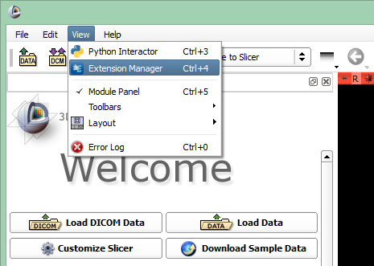

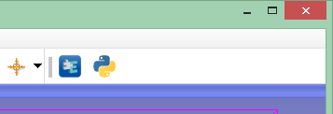
Install SlicerRT extension
or

Slide 6
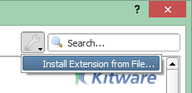
Install SlicerRT extension
Find the downloaded SlicerRT zip file on your computer

Slide 7
Install Gel Dosimetry Analysis extension
Find the downloaded Gel Dosimetry Analysis zip file on your computer Click Restart

Slide 8
Unpack tutorial datasets
Find the dataset you downloaded named WC2015_Gel_Slicelet_Dataset.zip
Unpack it to a local folder of your choice
Different for each operating system

Slide 9
Your concerns
“Largest obstacle to the use of Slicer RT and gel dosimetry in general is managing the complexity of the process and keeping track of and managing the large software feature set that is needed for the process to work well.”

Slide 10
Your concerns
“Concerned about validating results produced from these tools.”

Slide 11
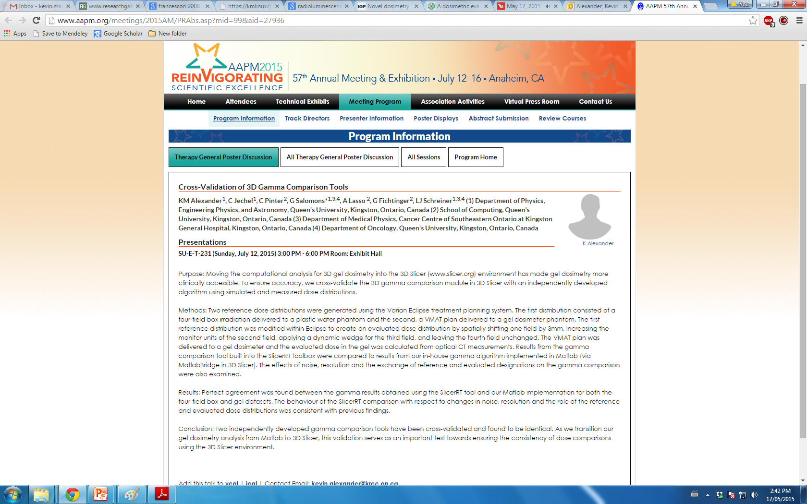
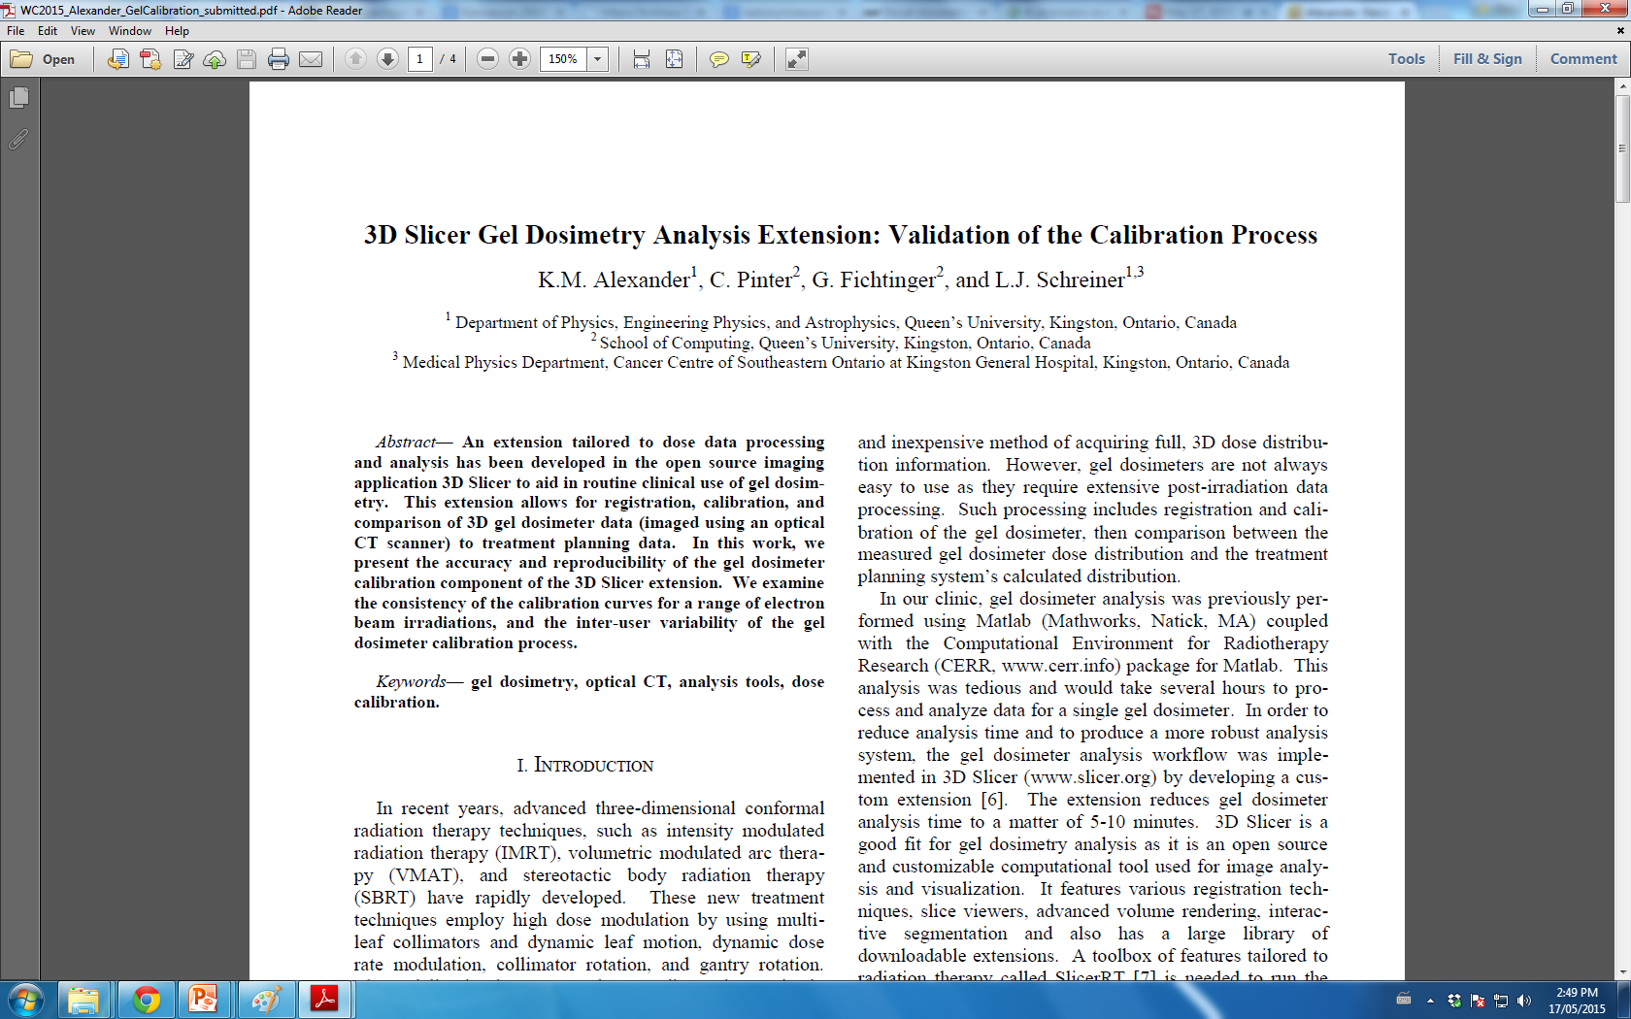
Your concerns
“Concerned about validating results produced from these tools.”
In progress!

Slide 12
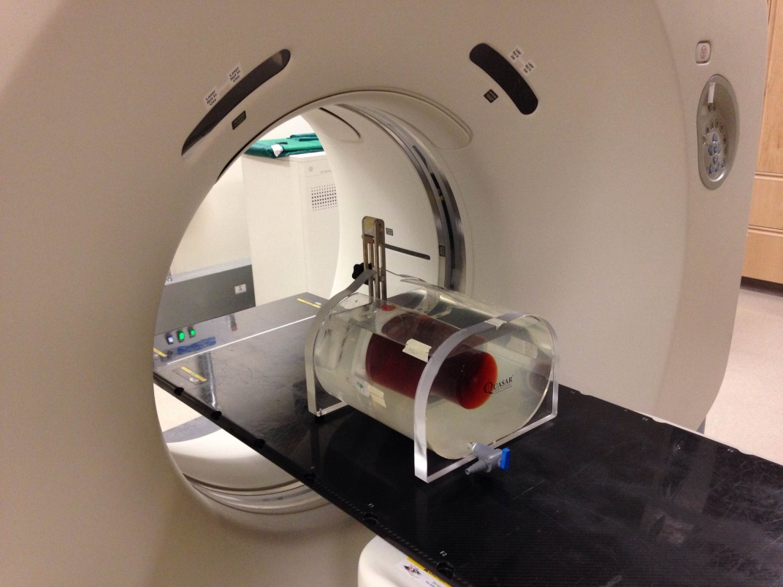
Where did this data come from?
Gel dosimeter was positioned inside a phantom, and CT simulation images were acquired (Planning CT volume)

Slide 13
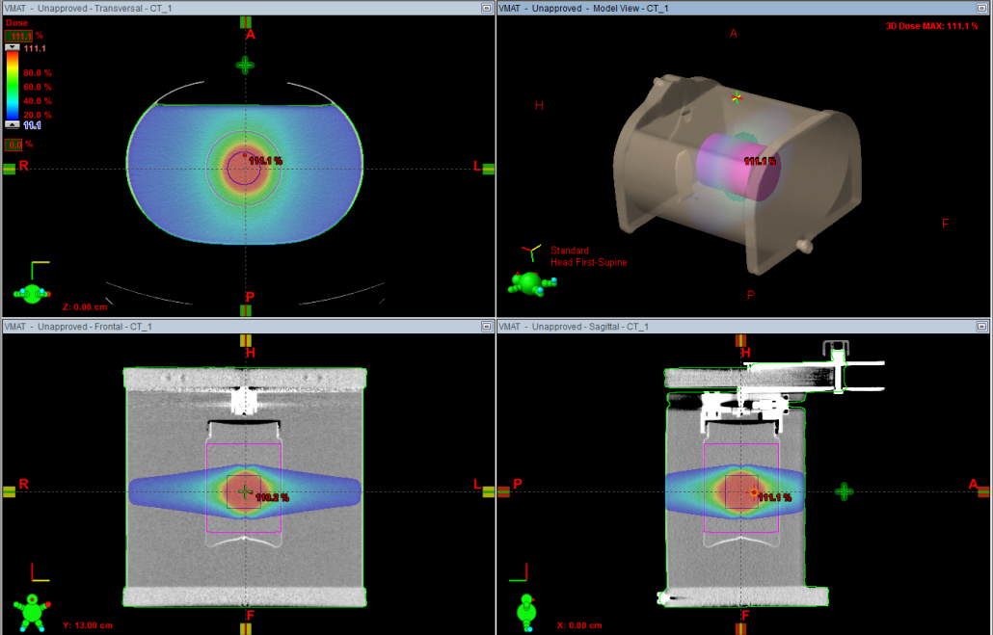
Where did this data come from?
Treatment planning using Eclipse:
Single arc delivery with fixed field size
Gel jar was contoured and dose distribution was calculated
Outputs: Planning dose volume, Structures

Slide 14
Where did this data come from?
Irradiation day:
Gel #1 is scanned using an optical CT scanner, then fiducial markings are made with a marker, and metal BBs are taped to those markings
Gel #2 is also optically scanned (no markings)
Phantom with gel is positioned on patient couch
Cone beam CT image is acquired using the On-Board Imager (OBI Volume)

Slide 15
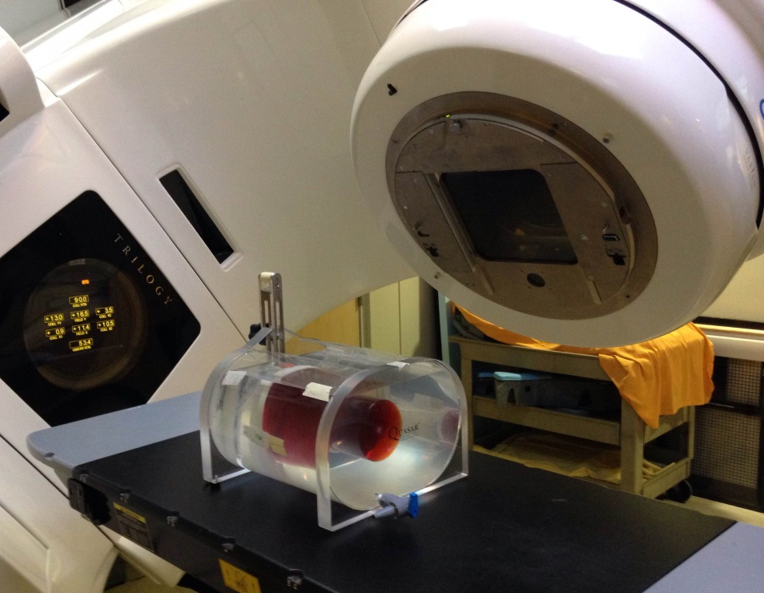
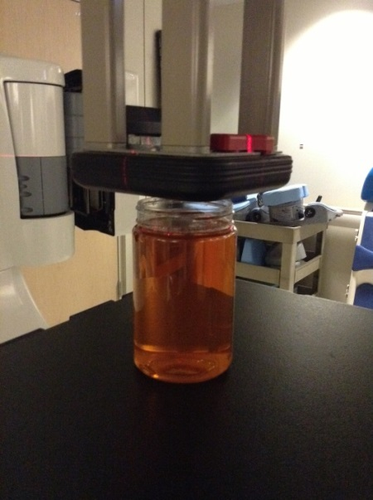
Where did this data come from?
Irradiation day:
Gel #1 is irradiated with planned delivery
Gel #2 is irradiated with an electron beam
Gel #1 Gel #2

Slide 16
Where did this data come from?
Irradiation day:
Both gels are scanned post-irradiation, and are reconstructed to create 3D digital volumes (Measured gel dosimeter volume, calibration gel volume)

Slide 17
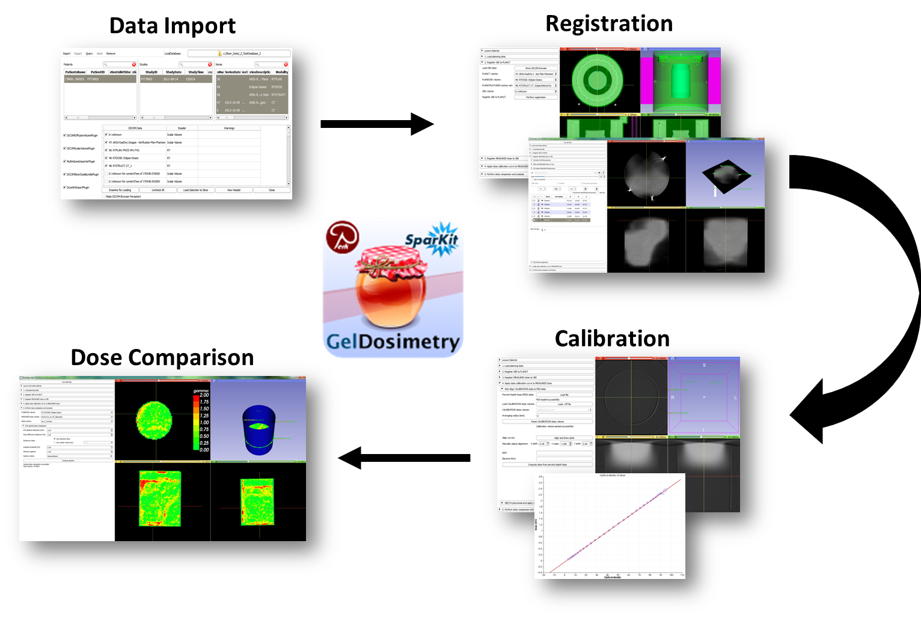
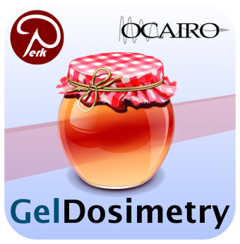
Gel Dosimetry Analysis Roadmap

Slide 18
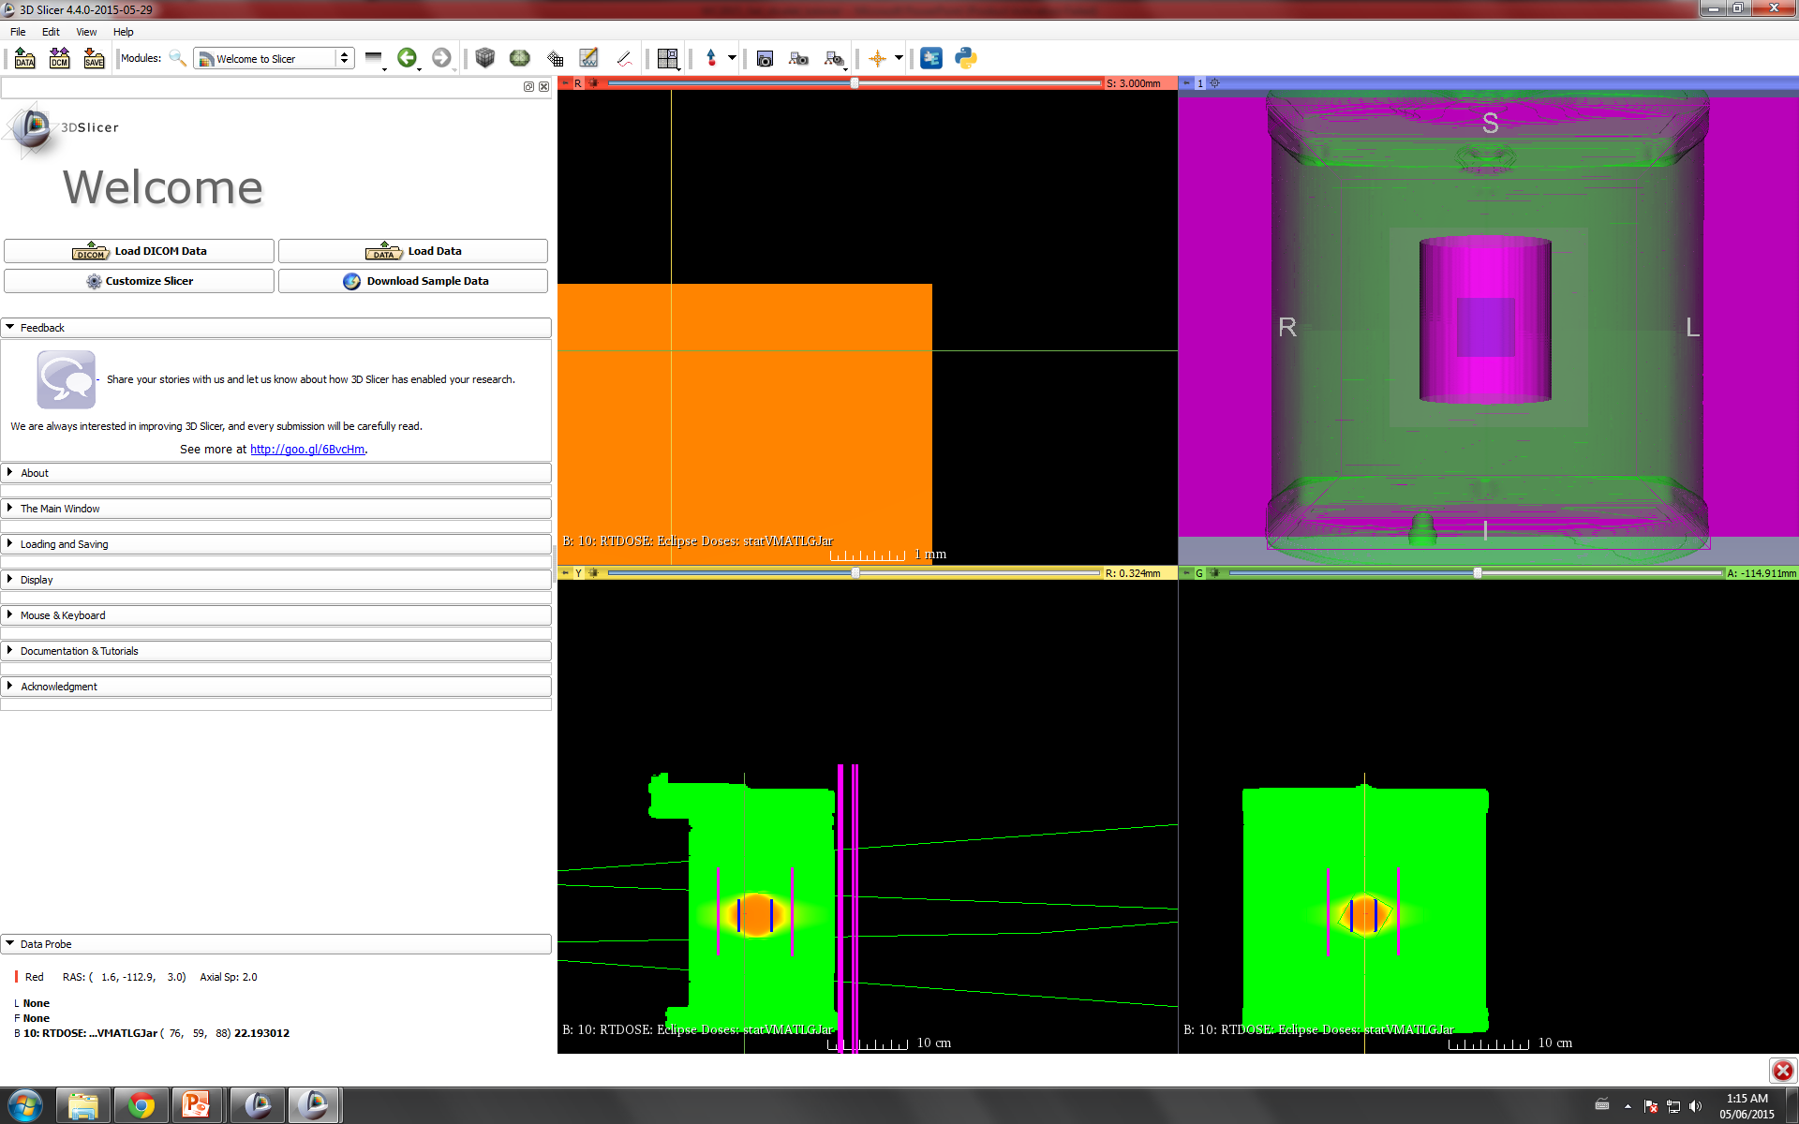

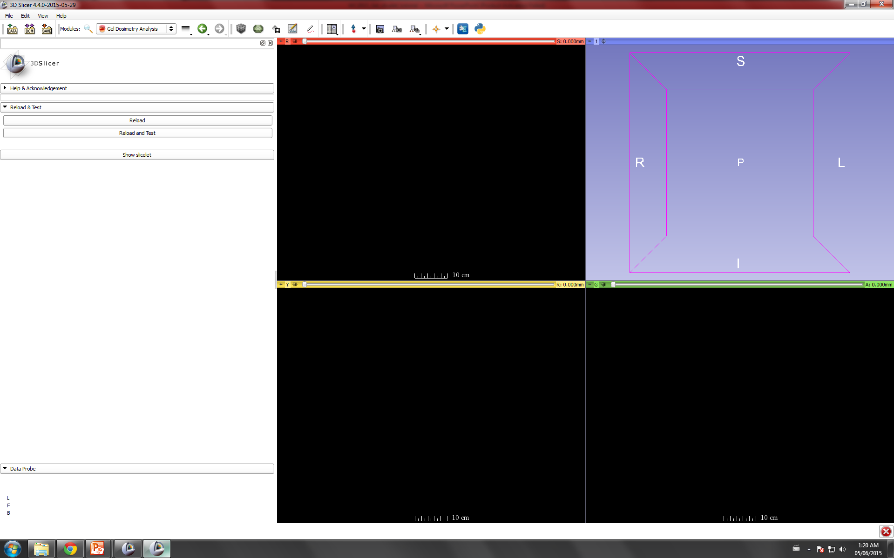
Open Gel Dosimetry Analysis Slicelet

Slide 19
Gel Dosimetry Analysis Roadmap

Slide 20
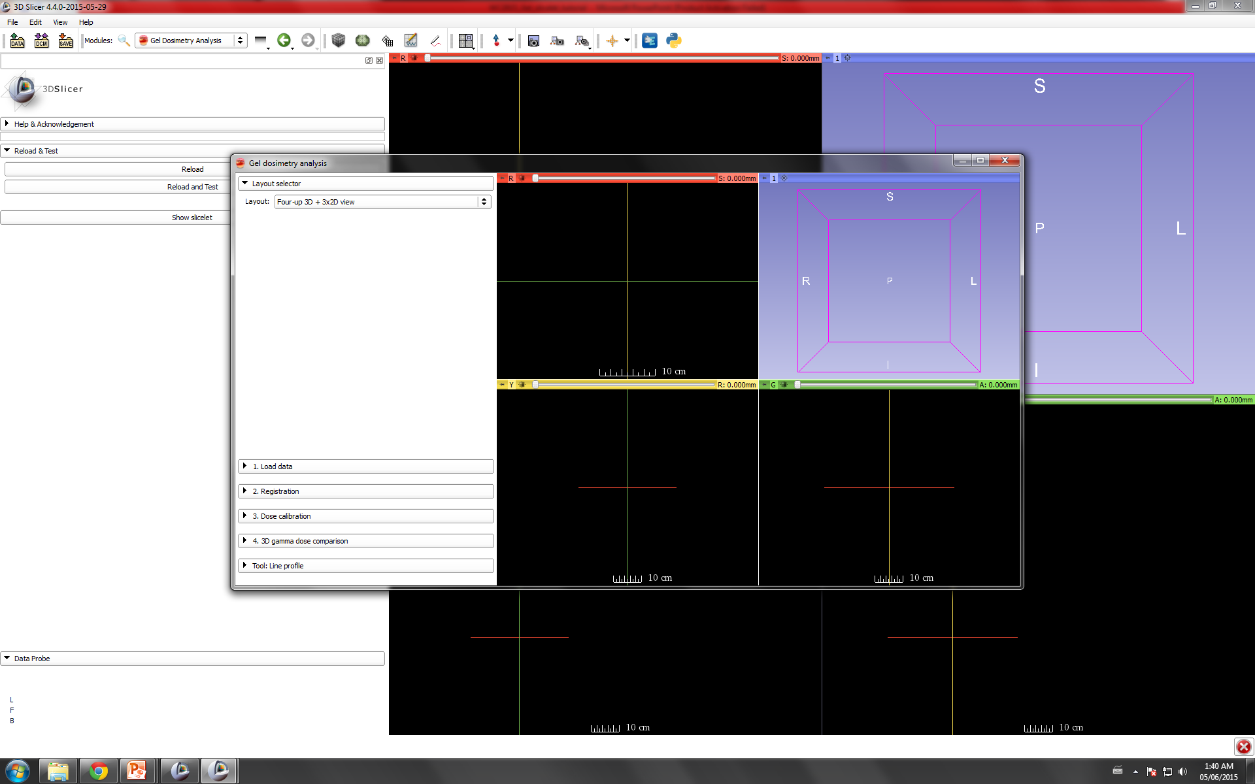
Gel Dosimetry Analysis Slicelet

Slide 21
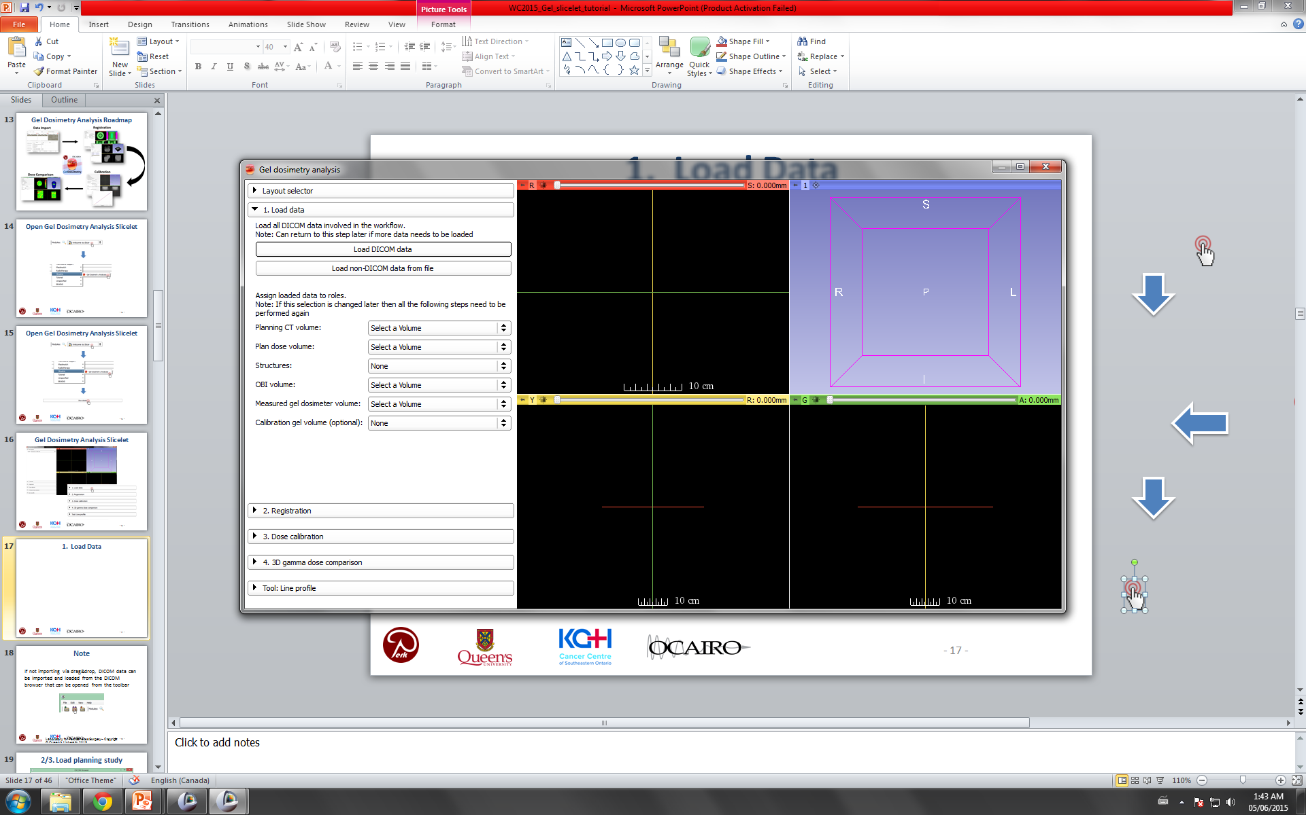
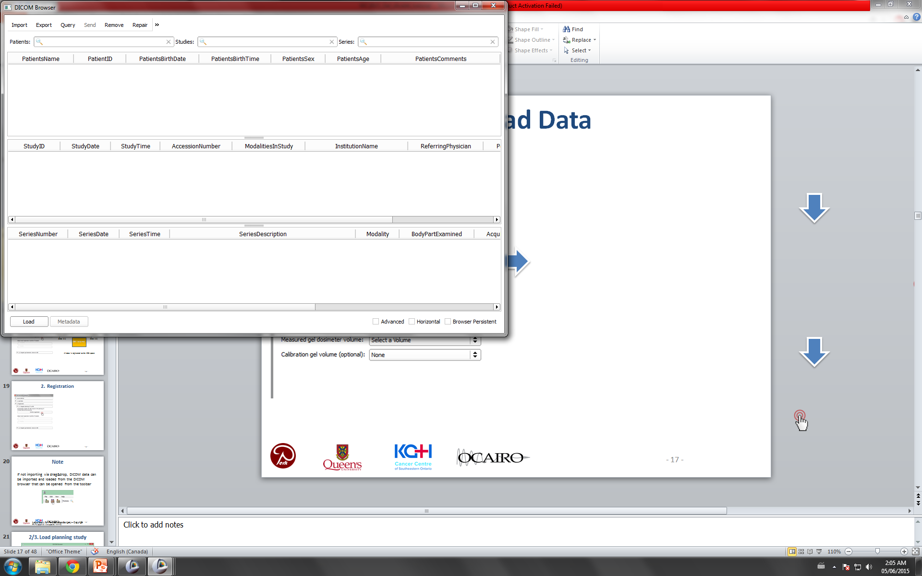
1. Load Data
Select ‘DICOM’ folder that was just downloaded

Slide 22
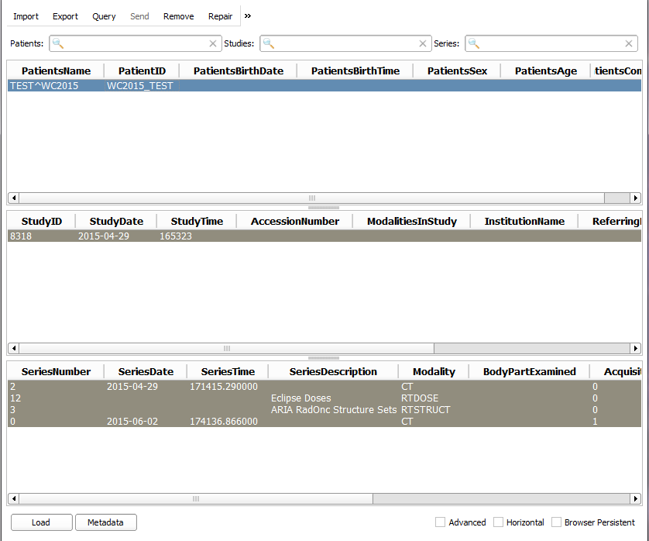
1. Load Data
Select all data objects, and click Load.

Slide 23
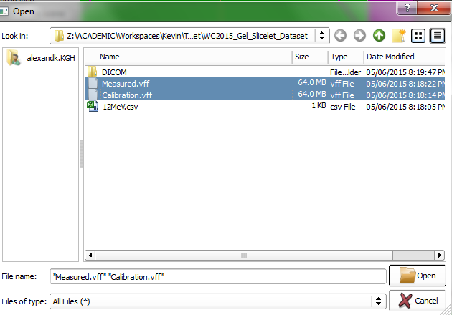
1. Load Data
Select Optical Gel VFF Files

Slide 24
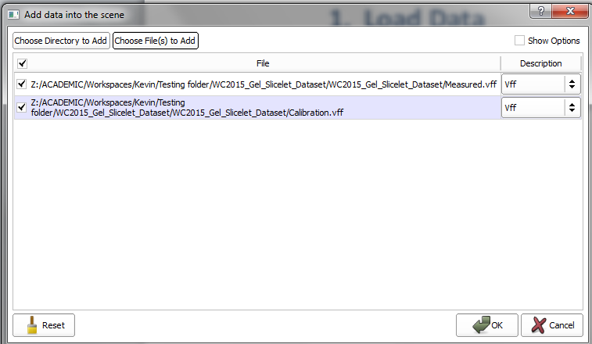
1. Load Data
Select Optical Gel VFF Files

Slide 25
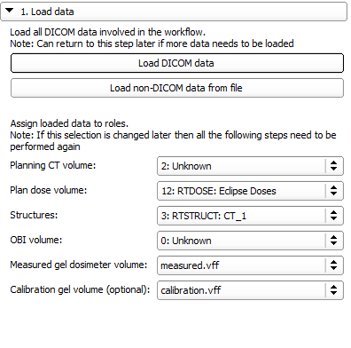
1. Load Data
Assign data as shown

Slide 26
Gel Dosimetry Analysis Roadmap

Slide 27
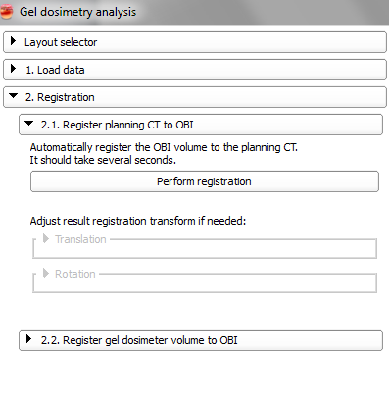
2. Registration
Planning CT Volume
Measured Gel Volume
Intensity based registration (Step 2.1)
Fiducial registration (Step 2.2)
OBI Volume
All data is registered to the OBI space

Slide 28
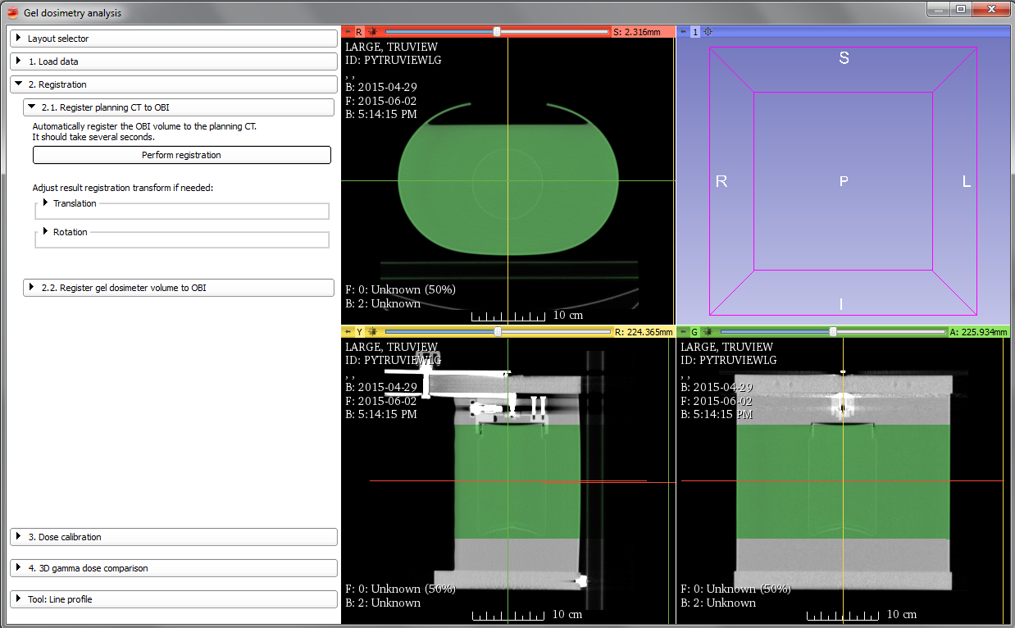
2.1 Registration
Planning CT Volume: Grey OBI Volume: Green

Slide 29
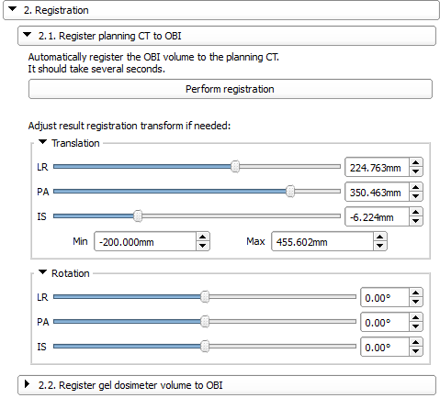
2.1 Registration
If auto-registration fails or needs adjusting, manual adjustments can be performed
Use up/down arrows, or type in value

Slide 30
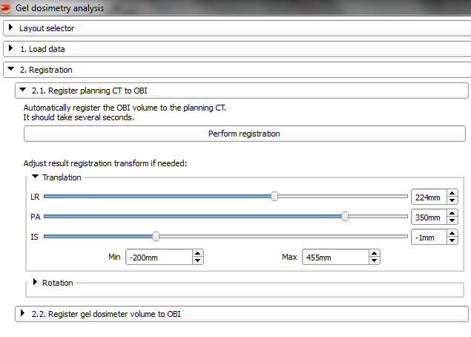
2.1 Registration
If auto-registration fails, or needs adjusting, manual adjustments can be performed
Use up/down arrows, or type in value
Notes:
For this case -1mm IS

Slide 31
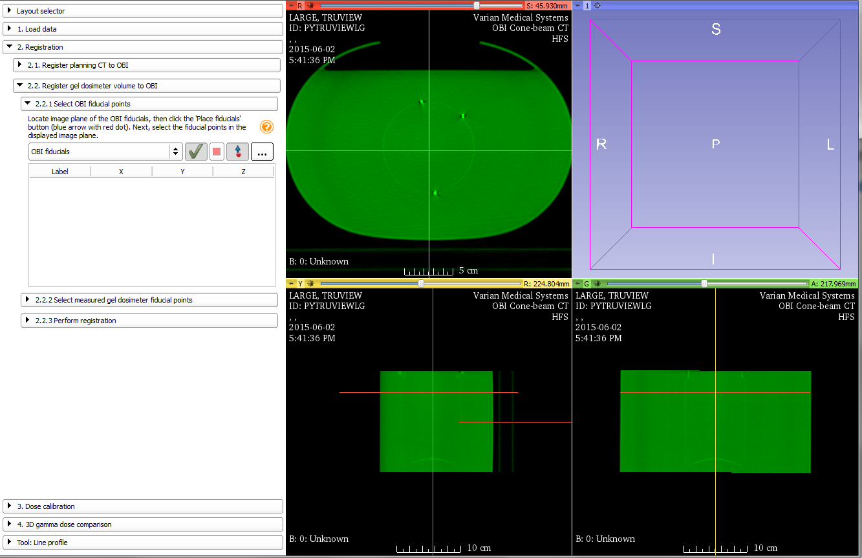
2.2 Registration
OBI fiducial point selection

Slide 32
2.2 Registration
OBI fiducial point selection
Tip: Hold the shift key and explore the volume

Slide 33
2.2 Registration
#3
#2
OBI fiducial point selection
#1

Slide 34
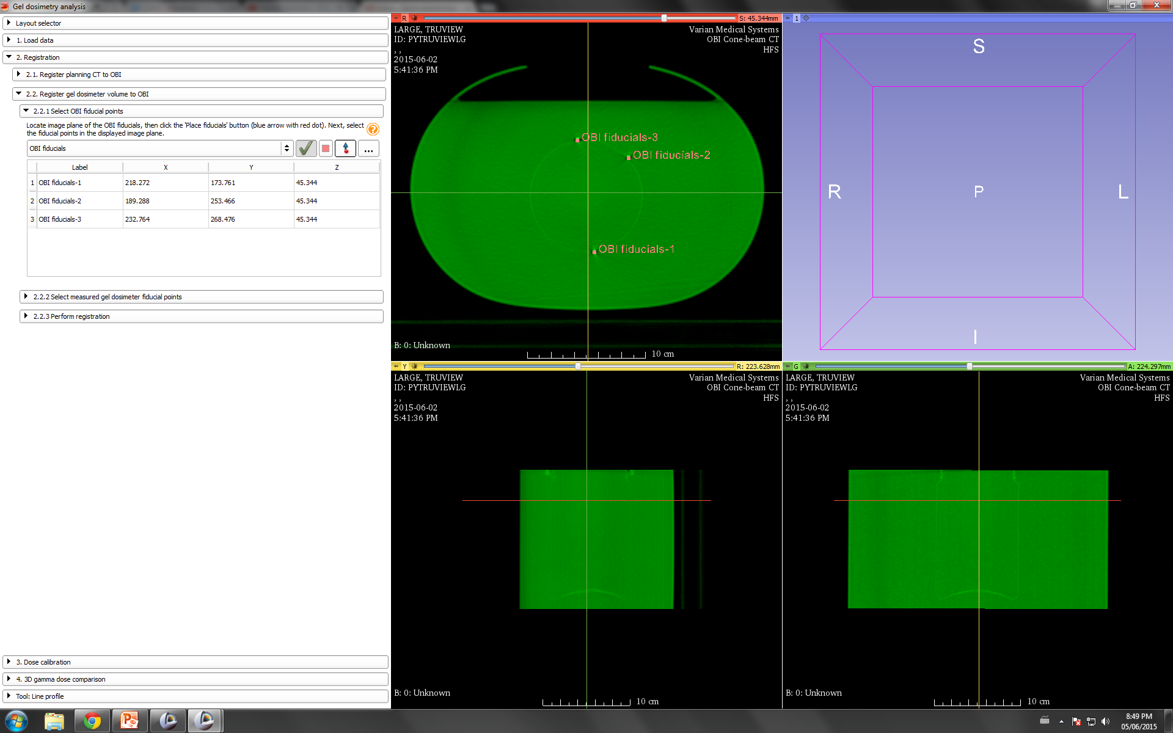
2.2 Registration
OBI fiducial point selection

Slide 35
2.2 Registration
Fiducial coordinates populate the table

Slide 36
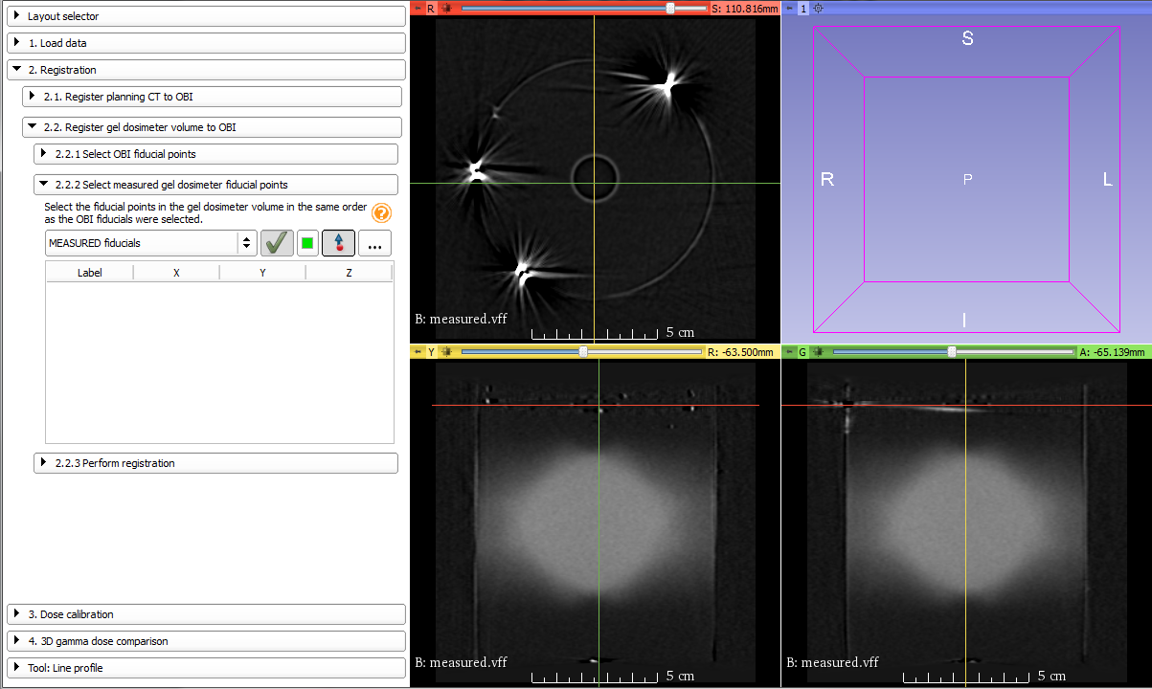
2.2 Registration
Optical CT fiducial point selection

Slide 37
2.2 Registration
Optical CT fiducial point selection
Tip: Adjust the window/level by clicking, holding, and dragging up/down and left/right

Slide 38
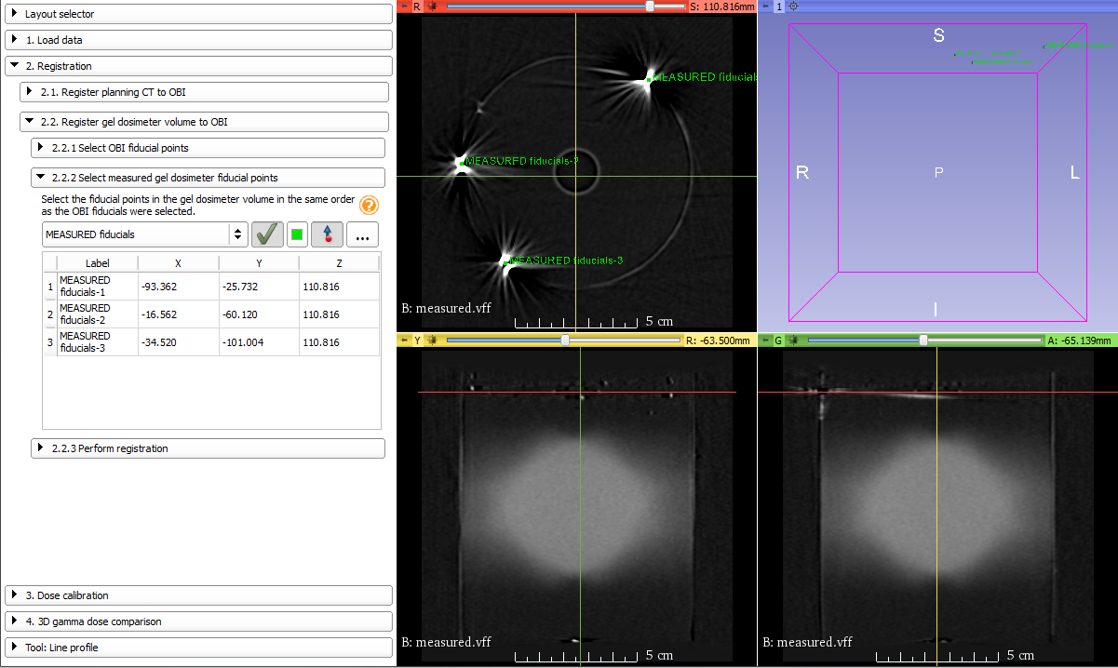
2.2 Registration
Optical CT fiducial point selection

Slide 39
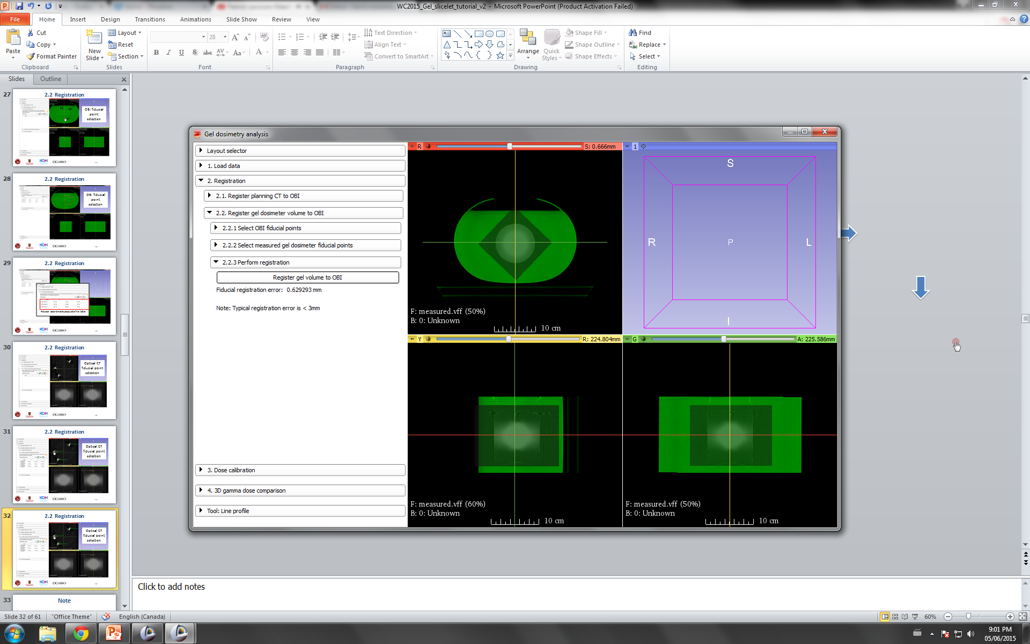
2.2 Registration

Slide 40
From our online survey
“How accurate is fiducial registration?”

Slide 41
From our online survey
“How accurate is fiducial registration?”
Root-mean square error between the two sets of fiducial points

Slide 42
Gel Dosimetry Analysis Roadmap

Slide 43
3. Calibration
Determine how optical density in the gel relates to dose
Here, we use a percent depth-dose (PDD) method about the central axis of the gel jar
We will align:
Gel optical density measurements
Water tank ion chamber PDD data

Slide 44
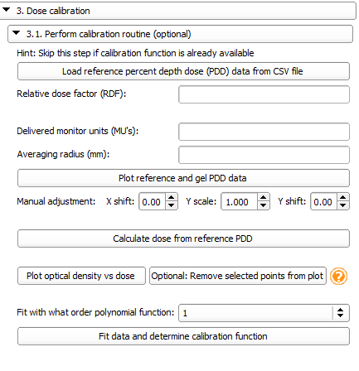
3.1 Calibration
Gel #2

Slide 45
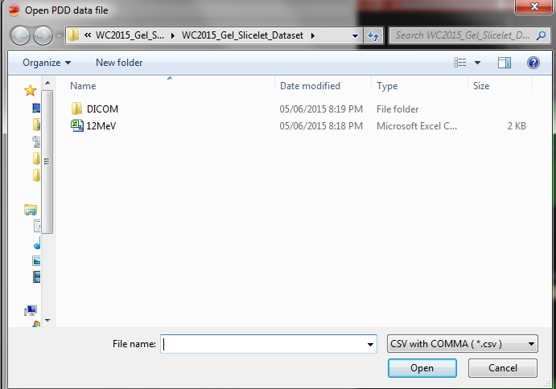
3.1 Calibration
Select 12MeV.csv file, and click ‘Open’

Slide 46
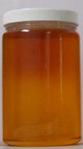
3.1 Calibration
For this delivery:
Relative dose factor (RDF) = 0.989
(6x6 cm², 12 MeV electron beam)
Delivered monitor units (MUs) = 300
Averaging radius (mm) = 5

Slide 47
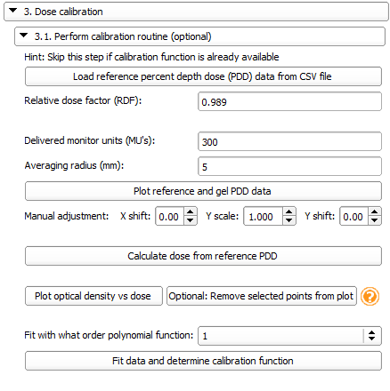
3.1 Calibration

Slide 48
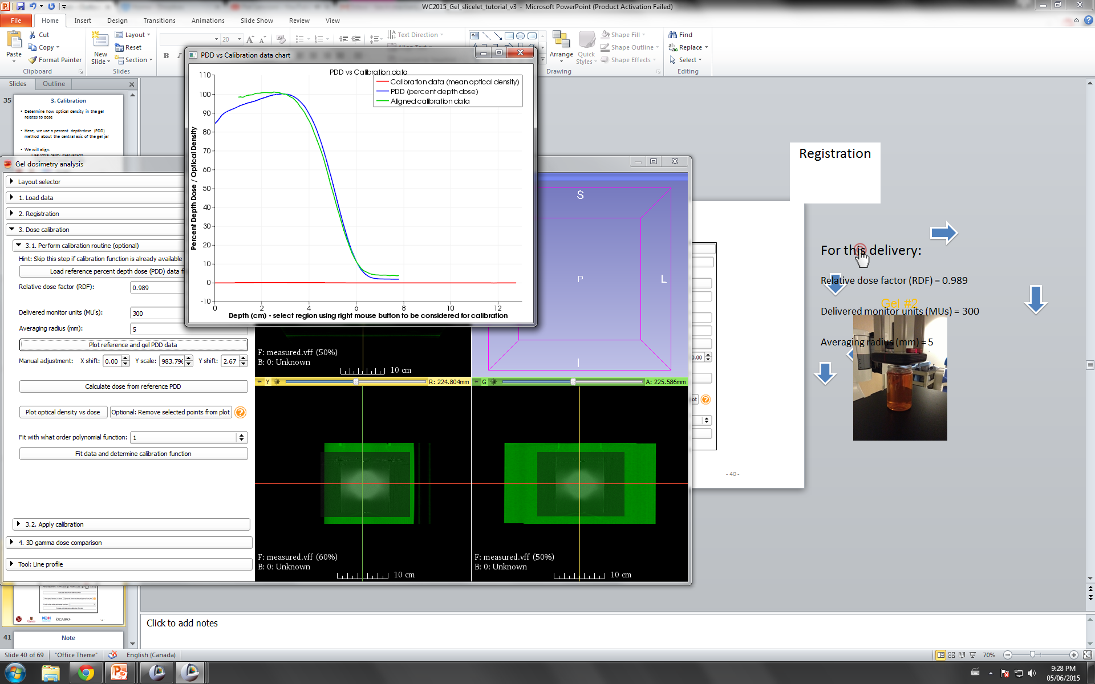
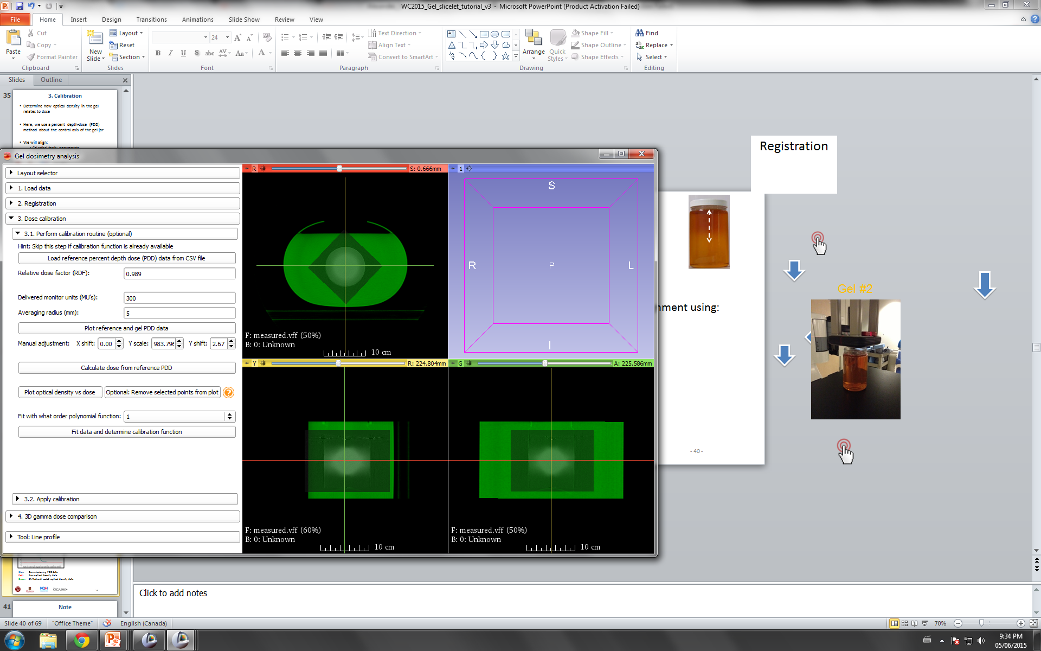
3.1 Calibration
Automated PDD alignment
Adjust alignment using:
Blue: Commissioning PDD data Red: Raw optical density data Green: Shifted and scaled optical density data

Slide 49
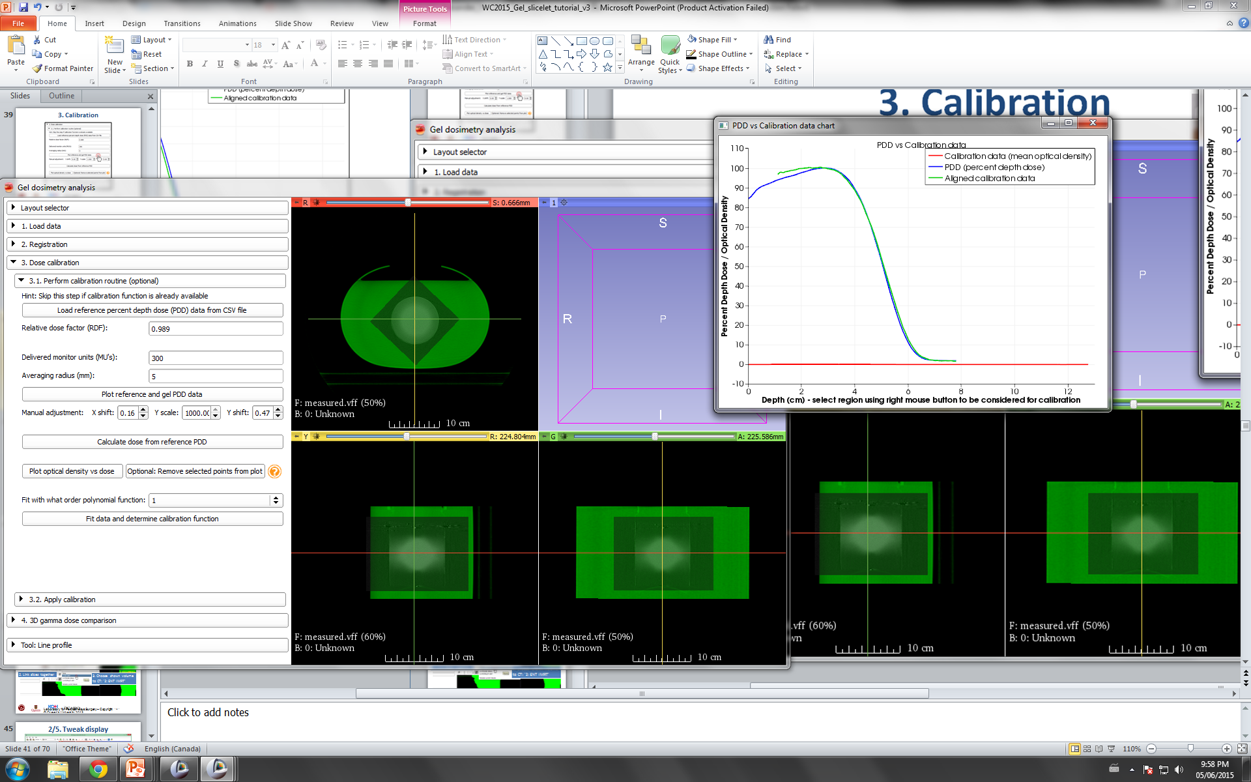
3.1 Calibration
Automated PDD alignment
Adjust alignment using:
Blue: Commissioning PDD data Red: Raw optical density data Green: Shifted and scaled optical density data

Slide 50
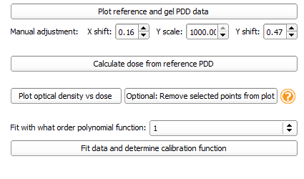
3.1 Calibration

Slide 51
3.1 Calibration

Slide 52
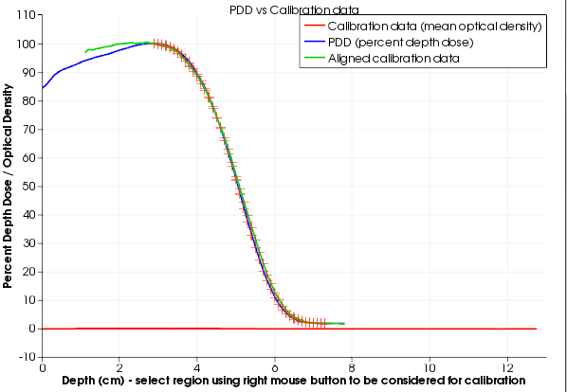
3.1 Calibration
Right click and draw box around region to use for calibration

Slide 53
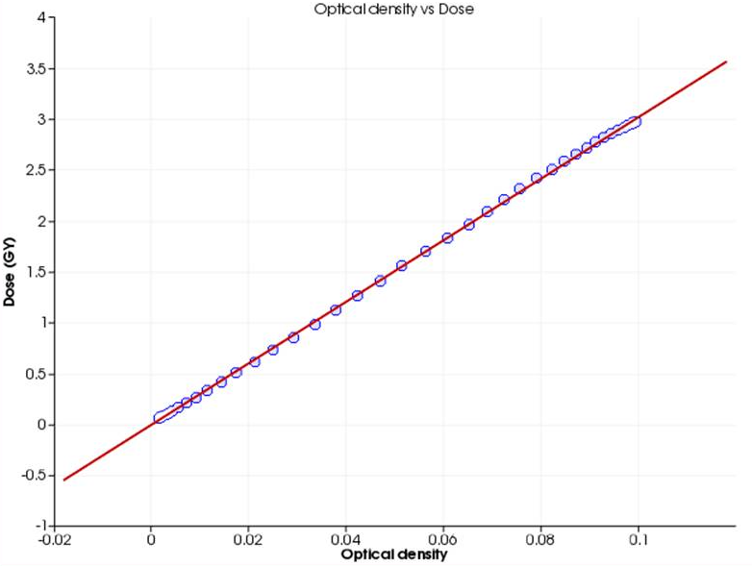
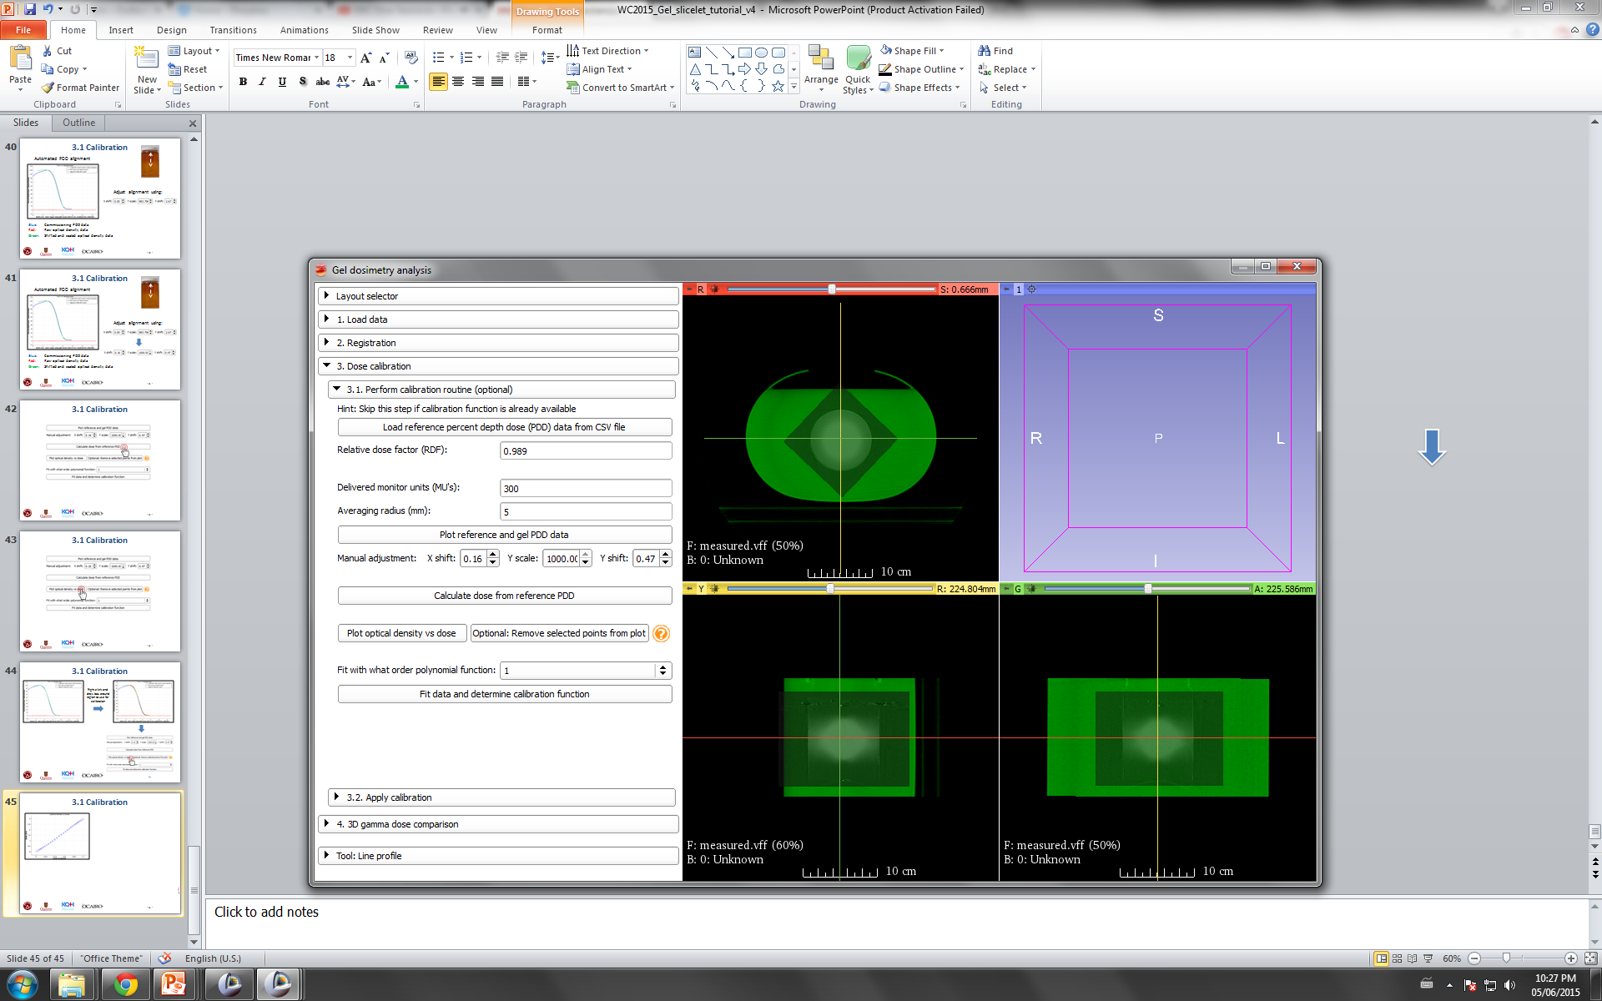
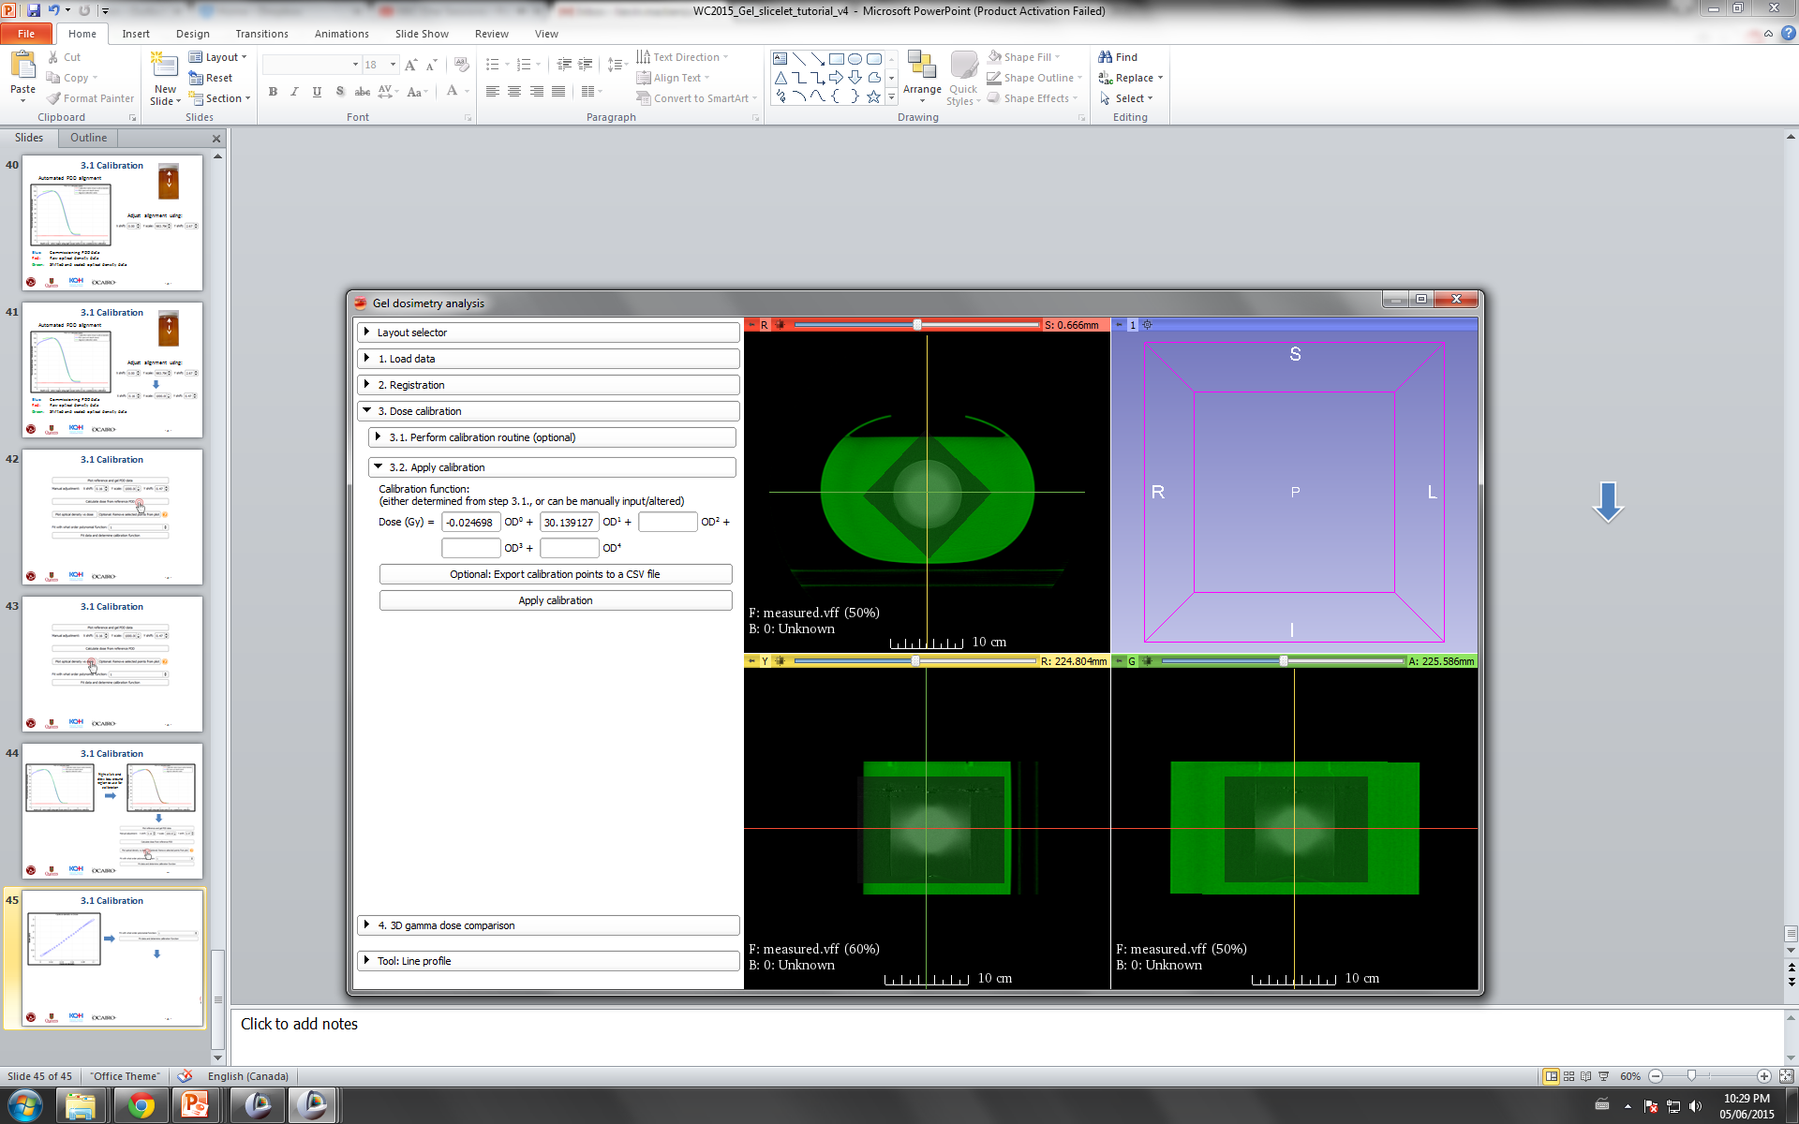
3.2 Calibration
Calibration function is determined and applied to measured gel volume

Slide 54
Gel Dosimetry Analysis Roadmap

Slide 55
4. Dose Comparison
Last step! Compare the measured gel dose volume with the planned dose volume (using the treatment planning system)
We will use a 3D gamma comparison
Criteria: 3% dose difference, 3mm distance-to-agreement

Slide 56
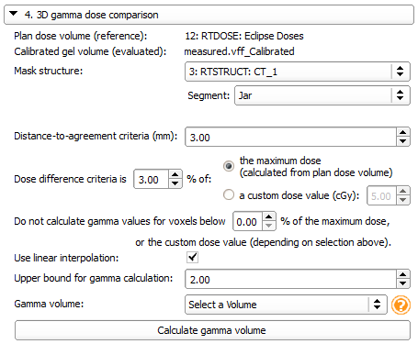
4. Dose Comparison
Volumes are automatically assigned
Select ‘CT_1’ structure set Choose the ‘Jar’ structure

Slide 57
4. Dose Comparison
Note: Two ways to specify dose difference

Slide 58
4. Dose Comparison
Dose threshold: Where to calculate gamma

Slide 59
4. Dose Comparison
Create new gamma volume

Slide 60
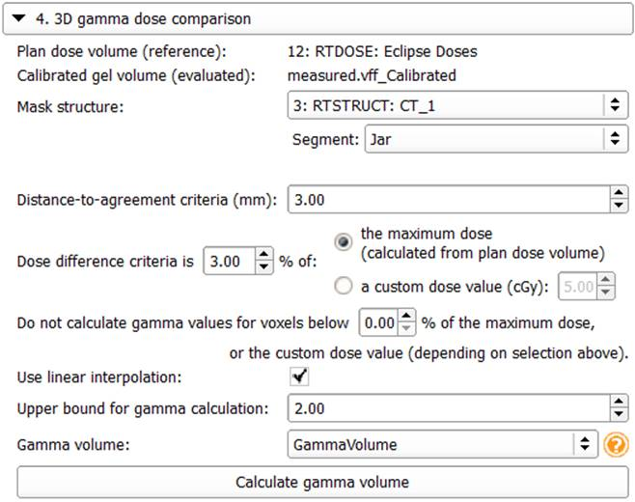
4. Dose Comparison

Slide 61
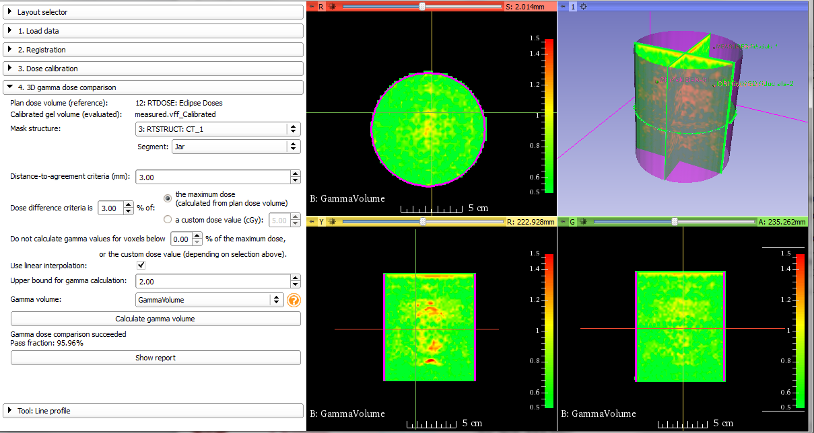
4. Dose Comparison

Slide 62
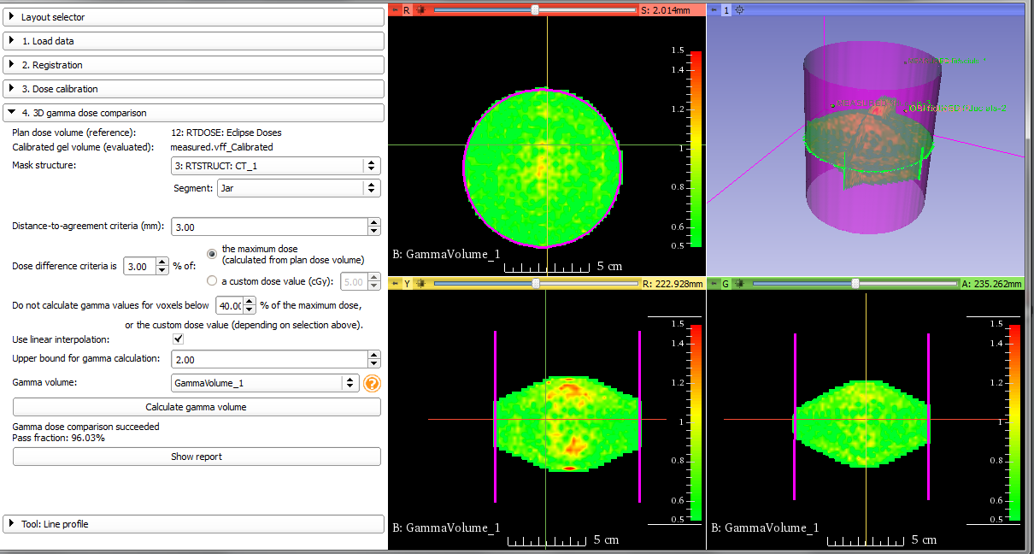
4. Dose Comparison
Dose threshold at 40% of max. dose

Slide 63
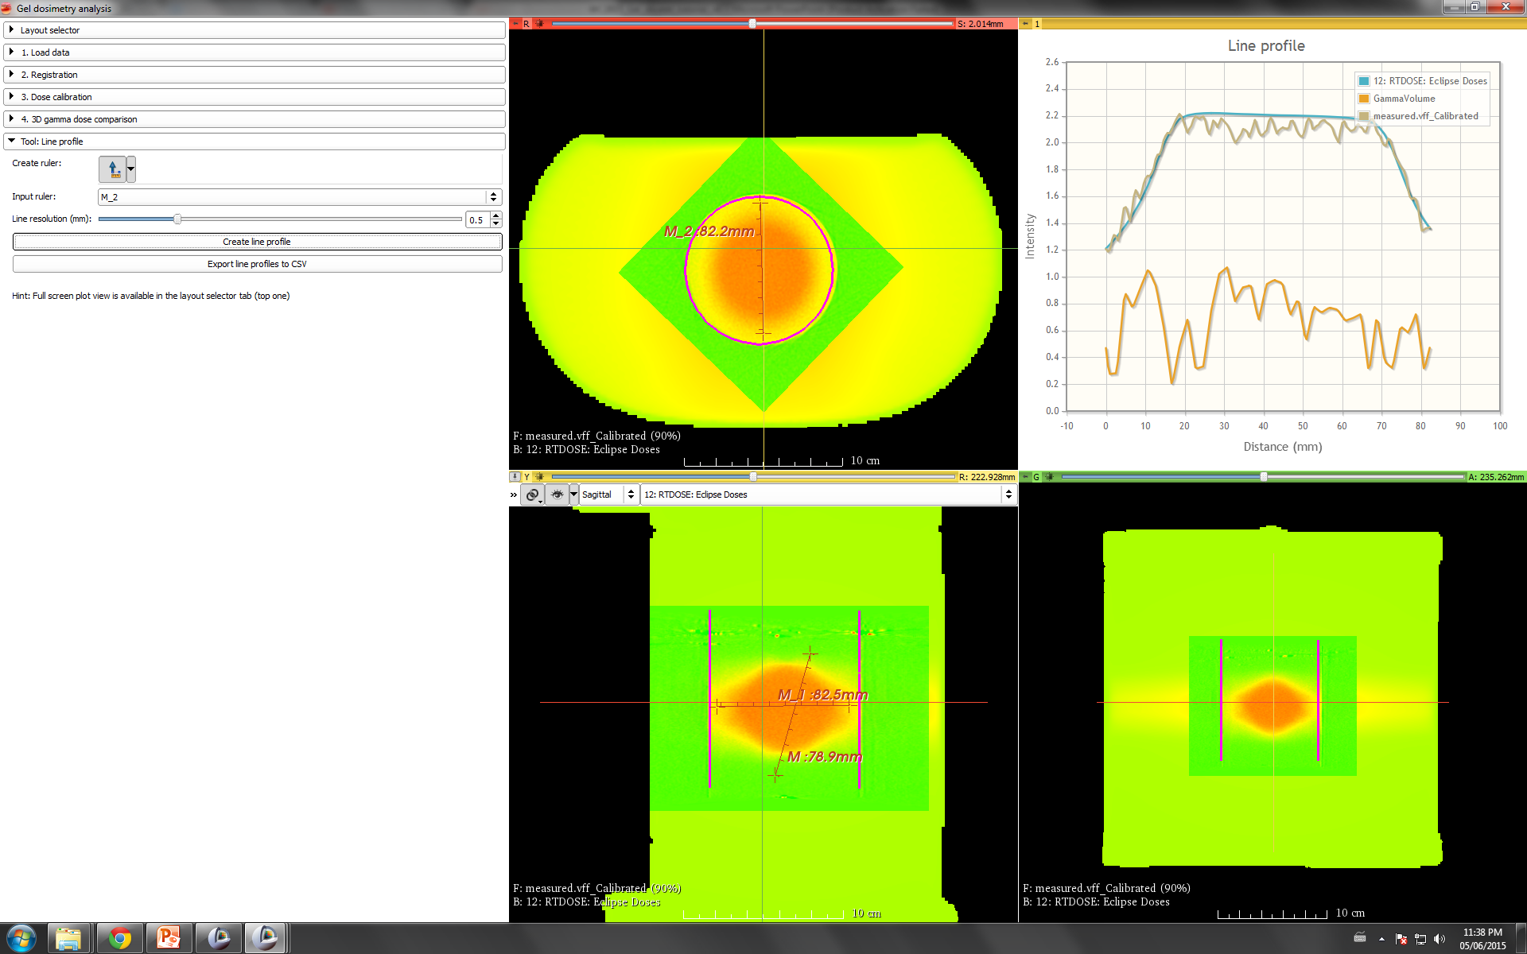

Line Profile
Draw line profile, with ruler tool, then click ‘Create line profile’ to view.

Slide 64
From our online survey
“Concerning Gel Dosimetry slicelet:
Is it possible to save the result of an analysis? What if I don't want to go over the procedure every time for the same piece of data?”

Slide 65


Slide 66


Slide 67
Wrap-up
Thanks for participating!
Let us know if you have any questions/suggestions
Have a great week and conference!

